Slide 1


ENVIRONMENT SENSING ROBOTIC ARM USING MACHINE LEARNING
Team members: Luckshanya A K - 21BEC1171
Prathana S - 21BEC1624
Niranjana D - 21BEC1655

Slide 2
OBJECTIVE
Evaluate the functionality and performance of the robotic arm in executing designated tasks, focusing on precision, speed, and adaptability.
Assess the efficacy of machine learning algorithms integrated into the robotic arm, emphasizing real-time responsiveness and learning capabilities.
Scrutinize the project documentation for clarity, completeness, and organization, highlighting strengths and areas that require improvement.
Gauge the overall success of the project in achieving predefined goals and milestones, considering both technical and practical aspects.
Provide constructive feedback to enhance the robotic arm's performance and suggest potential avenues for scalability in future applications.

Slide 3
ABSTRACT
This project review delves into the intersection of artificial intelligence and machine learning within the realm of robotics, specifically focusing on the development of a robotic arm.
The objective is to comprehensively evaluate the efficacy of machine learning algorithms employed in enhancing the arm's functionality, precision, and adaptability.
The assessment encompasses the real-time responsiveness and learning capabilities of the robotic arm, exploring the synergy between artificial intelligence and physical automation.
The project's documentation is scrutinized for clarity and completeness, serving as a valuable resource for understanding the intricacies of integrating machine learning into robotic systems.
The findings from this review contribute to the evolving landscape of artificial intelligence in robotics, offering insights for further advancements and applications in autonomous and intelligent systems.

Slide 4
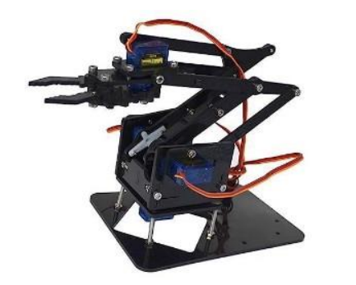
COMPONENTS USED
Ardiuno Board
Wires
sensors
Bolts & screws
Pick and place arm
Hydraulic pusher
Metal
Servo motor

Slide 5
LITERATURE REVIEW
TITLE AND AUTHOR | SUMMARY OF LITERATURE | REFERENCES
Review of machine learning methods in soft robotics. Kim D, Kim S-H, Kim T, Kang BB, Lee M, Park W, et al. (2021) Published on February 18, 2021 | Soft robots have been extensively researched due to their flexible, deformable, and adaptive characteristics. They have complex behavior due to non-linearity. This paper presents existing machine learning techniques in the soft robotic fields and categorizes the implementation of machine learning approaches in different soft robotic applications, which include soft sensors, soft actuators, and applications such as soft wearable robots. | 1.Rus D, Tolley MT. Design, fabrication and control of soft robots. PubMed/NCBI Google Scholar 2.Bao G, Fang H, Chen L, Wan Y, Xu F, Yang Q, et al. Soft robotics: Google Scholar

Slide 6
A review of robot learning for manipulation: challenges, representations, and algorithms Oliver Kroemer, Scott Niekum, George Konidaris Published on 01 January 2021 | A key challenge in intelligent robotics is creating robots that are capable of directly interacting with the world around them to achieve their goals. The last decade has seen substantial growth in research on the problem of robot manipulation, which aims to exploit the increasing availability of affordable robot arms and grippers to create robots capable of directly interacting with the world to achieve their goals. Learning will be central to such autonomous systems, as the real world contains too much variation for a robot to expect to have an accurate model of its. | Ben Abbatematteo, Stefanie Tellex, and George Konidaris. Learning to generalize kinematic models to novel objects. Pieter Abbeel and Andrew Y Ng. Apprenticeship learning via inverse reinforcement learning. In Proceedings of the 21st International Conference on Machine learning

Slide 7
A Survey of Robot Learning Strategies for Human-Robot Collaboration in Industrial Settings Debasmita Mukherjee, Kashish Gupta, Li Hsin Chang, Homayoun Najjaran Published on February 2022 | The levels of human-robot interaction and various aspects of safety, human motion intention prediction, learning by demonstration within the preview of human-robot collaboration (HRC) and realised through recent advances in ML have been explored. | M. Fechter et al. Axiomatic design approach for human-robot collaboration in flexibly linked assembly layoutsProcedia CIRP(2016) G. Michalos et al. Automotive assembly technologies review: challenges and outlook for a flexible and adaptive approach CIRP J. Manuf. Sci. Technol. (2010)

Slide 8
PROPOSED METHODOLOGY
Sensor Used:
Camera: For visual recognition and object detection.
Ultrasonic sensors: For distance measurement and obstacle detection.
Force/torque sensors or Hydraulic pusher: For measuring the force applied during gripping and lifting.
Servo motor: To control the precise movement and positioning of various segments or joints of the robotic arm(360 deg rotation).
Arduino board: serves as the brain or central control unit, coordinating the various components and operations of the robotic arm.
Wires, Bolts & screws: for connection

Slide 9
Machine Learning Model Development:
Object recognition/classification: Identifying different objects to be picked and placed.
Grasping strategy: Determining the best gripping approach based on object shape, size, and weight.
Motion planning: Generating optimal trajectories for pick and place actions considering obstacle avoidance and task efficiency.
Evaluation tools:
Software for data preprocessing(Arduino IDE)
software language used: C program
machine learning libraries/frameworks for model development
simulation environments for testing.

Slide 10
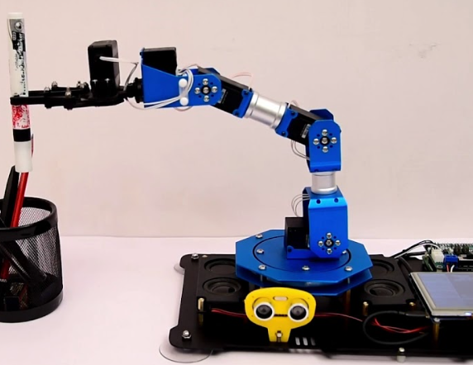
environment sensing pick and place robotic arm

Slide 11
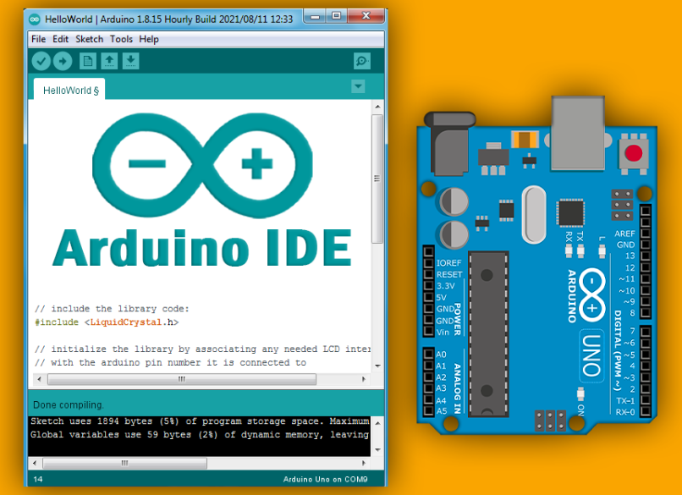
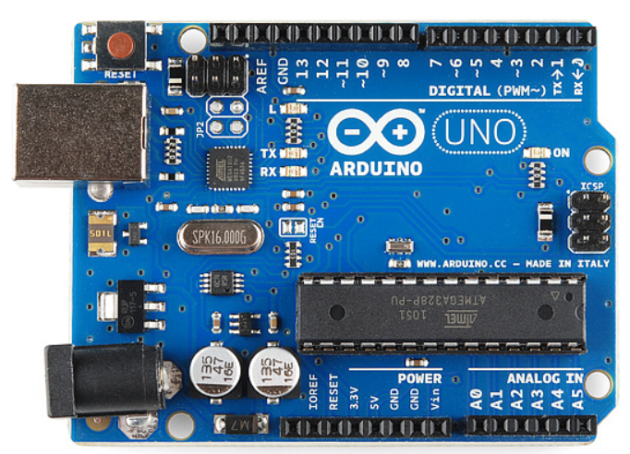
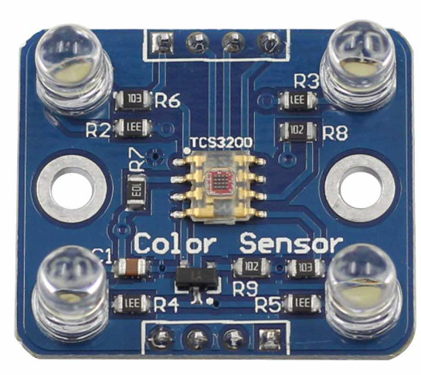
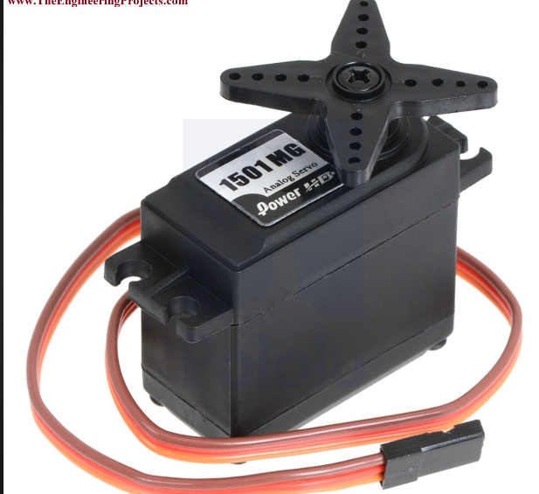
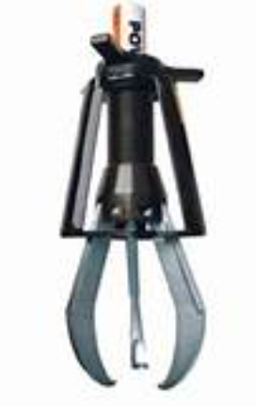
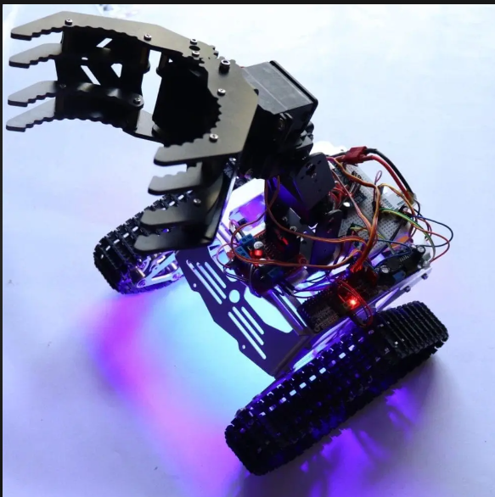
FLOW CHART
Software tool
Data processing
Arduino board
Environment sensing sensor
Servo meter
Hydraulic pusher
Pick and place

Slide 12
Application:
Food Processing and Packaging:The arm can detect and classify different types of food products, ensuring gentle handling during picking and packing processes.
Medical and Pharmaceutical Industries: In pharmaceutical manufacturing or medical laboratories, robotic arms with machine learning sensors can assist in sorting, handling, and packaging medications or laboratory samples.
E-commerce Order Fulfillment:can play a crucial role in automating order picking and packing tasks.
Warehousing and Logistics: The arm can move items from shelves or storage racks to packing stations or shipping containers.
Conclusion and Future Recommendations:
Emphasize the project's contributions to the field of artificial intelligence and machine learning in robotics, underscoring the potential for broader applications and advancements in intelligent automation.

Slide 13
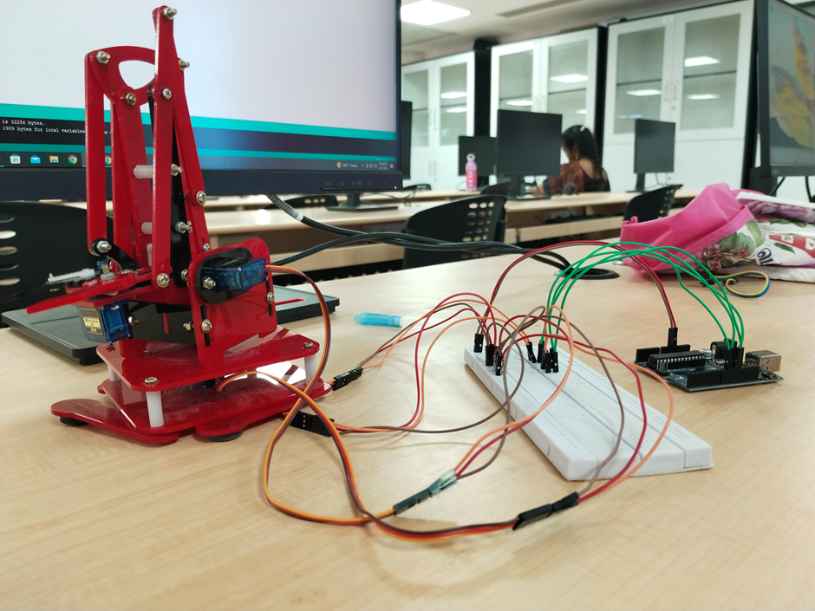
Robotic arm

Slide 14
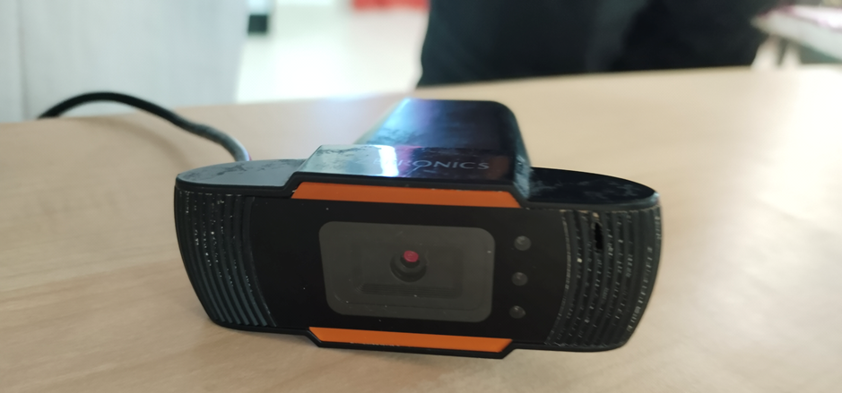
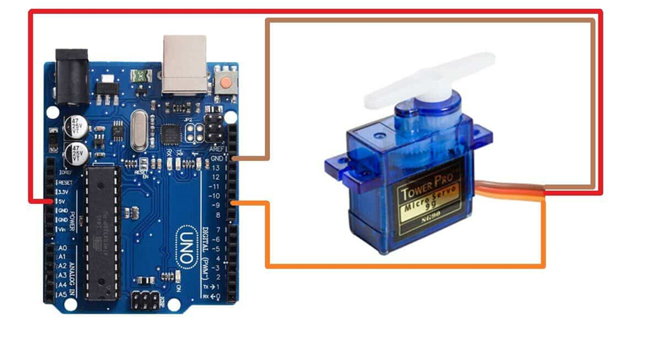
Components used
arduino
robotic arm
jumper wire
power supply
camera
raspberry pi
connecting cables
servo motor
bread board
VCC
GND
Trigger

Slide 15
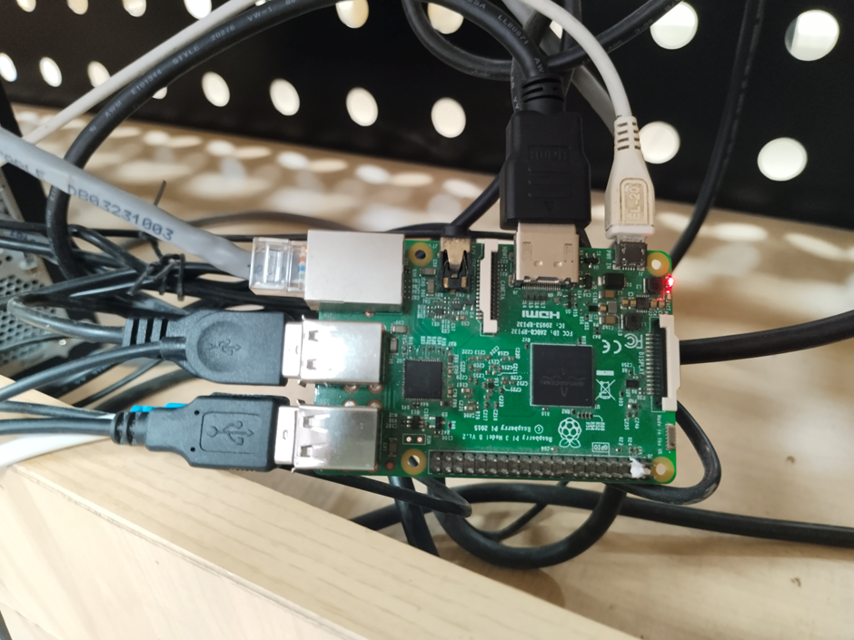
Raspberry pi connection

Slide 16
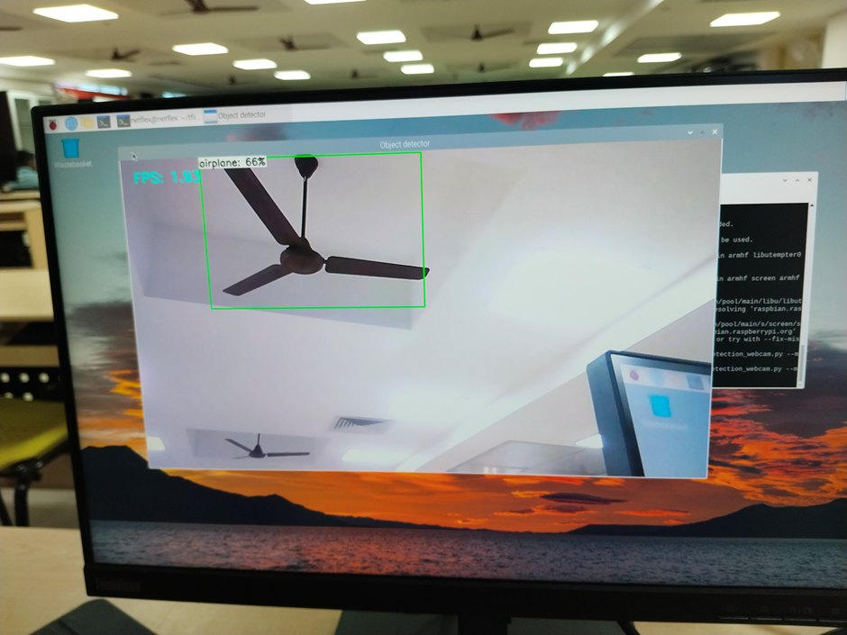
sensing figure

Slide 17
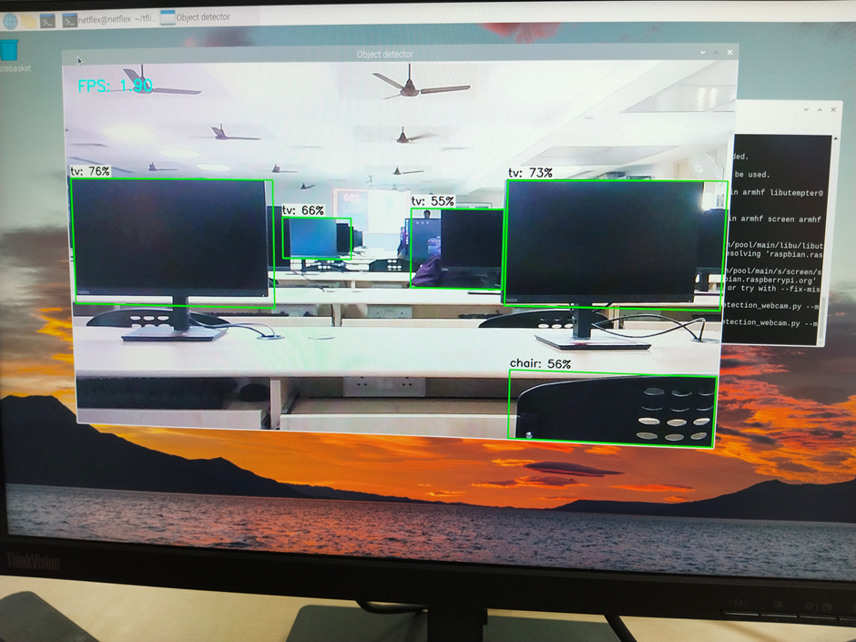

Slide 18
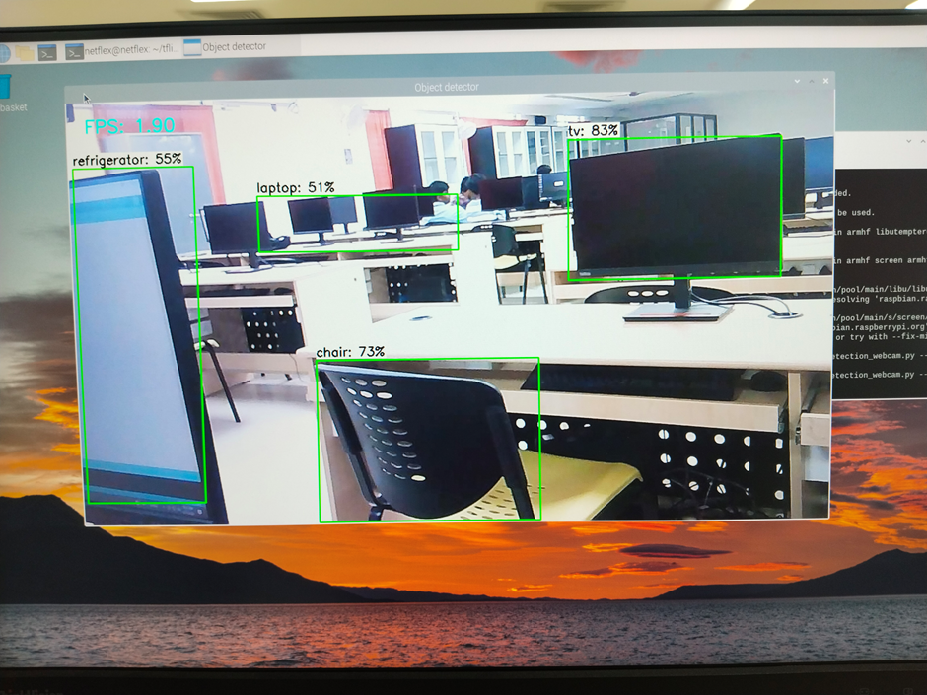

Slide 19
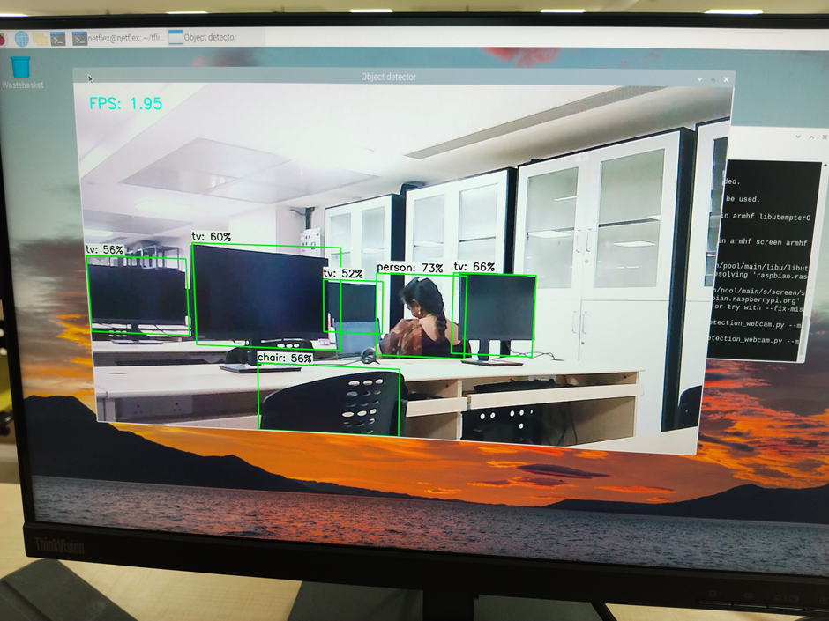

Slide 20
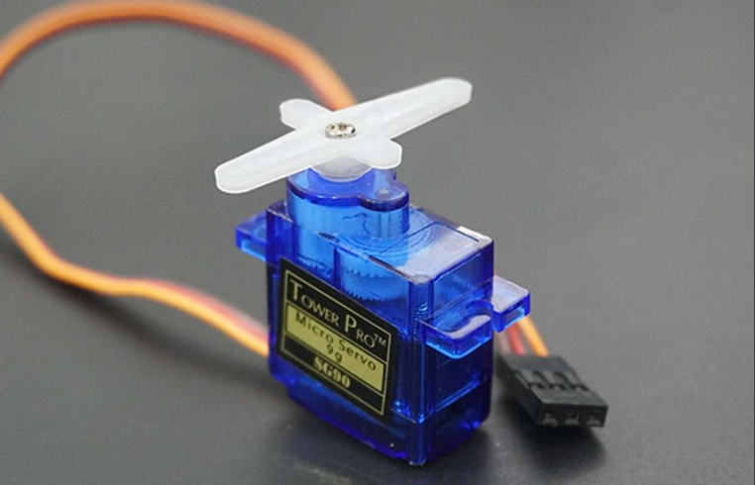
4 SERVO MOTOR USED
servo motor 1 - claw
servo motor 2 - height adjustment
servo motor 3 - rotation
servo motor 4 - distance adjustment

Slide 21
Arduino code
#include <Servo.h> Servo servo1; // Define servo objects Servo servo2; Servo servo3; Servo servo4; void setup() { servo1.attach(9); // Attach servos to pins servo2.attach(10); servo3.attach(11); servo4.attach(12); } void loop() { for(int i = 0;i<180;i++){ servo3.write(i); delay(15); } for(int i = 180;i<0;i--){ servo3.write(i); delay(15); } for(int i = 0;i<180;i++){ servo1.write(i); delay(15); }

Slide 22
for(int i = 180;i>0;i--){ servo1.write(i); delay(15); }
for(int i = 45;i<0;i--){ servo2.write(i); delay(15); } for(int i = 45;i>0;i--){ servo2.write(i); delay(15); } for(int i = 30;i<0;i--){ servo4.write(i); delay(15); } for(int i = 30;i>0;i--){ servo4.write(i); delay(15);
}}

